Slide 1
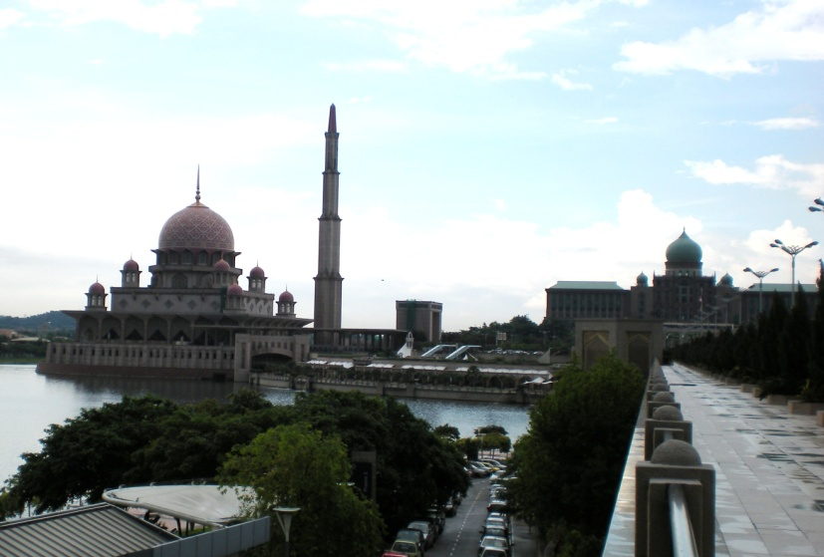
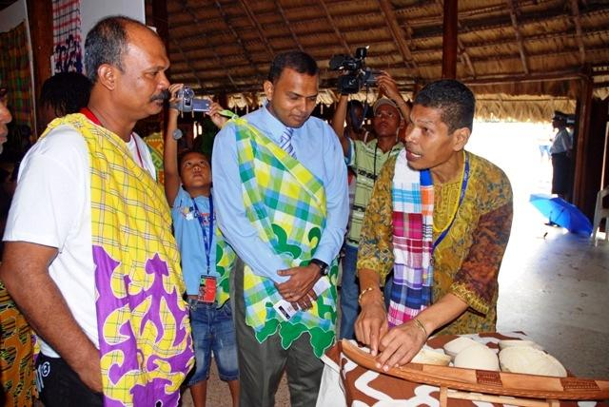
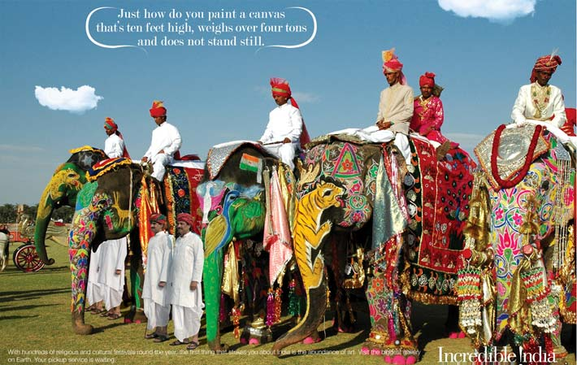
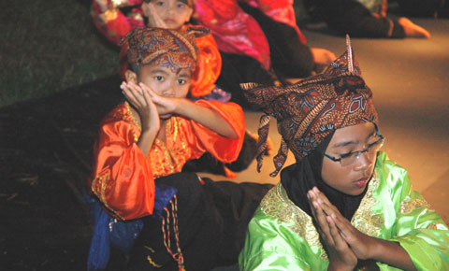
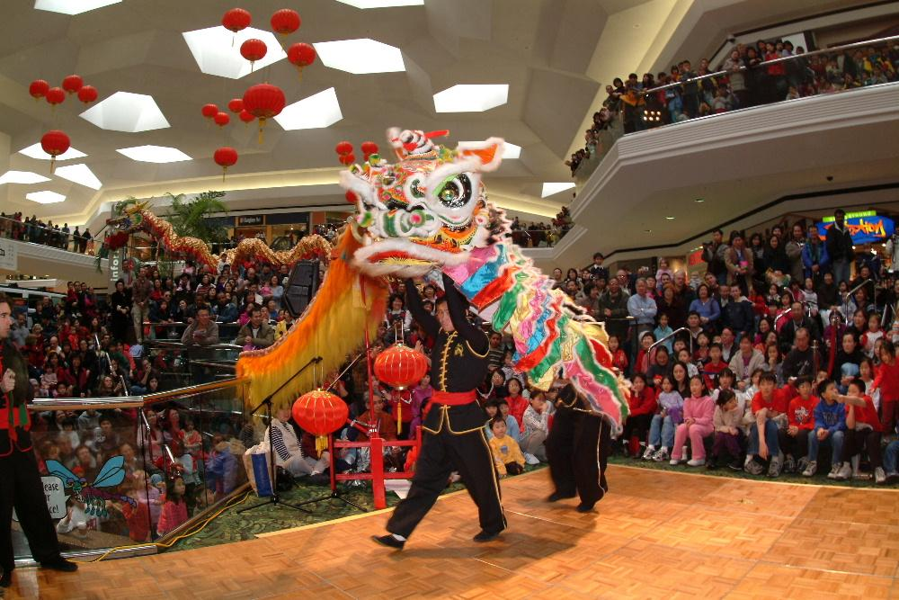
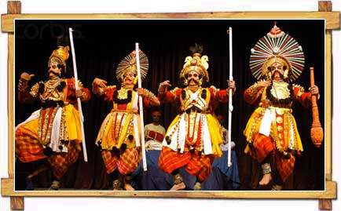
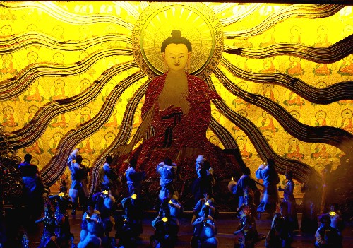
CULTURE

Slide 2
DEFINITION
CONCEPT OF CULTURE
ELEMENTS OF CULTURE
HOFSTEDE’S 5 DIMENSION OF NATIONAL CULTURE
CAUSES OF CULTURE DIFFERENCE
WHY AND HOW THE CULTURE CHANGE
BEHAVIORAL PRACTICS AFFECTING BUSINESS
RECONCILIATION OF INTERNATIONAL DIFFERENCES

Slide 3
DEFINITION
Culture consists of specific learned norms based on attitudes, values, and beliefs, all of which exist in every society – by John D. Daniels & Lee H. Radebaugh, 8th edition, 1998.
Culture is defined as the values, attitudes, beliefs, artifacts and other meaningful symbols represented in the pattern of life adopted by people that help them interpret, evaluate and communicate as members of a society– by V. Kumar, 2000

Slide 4
DEFINITION cont..
Culture configuration of learned behavior and results of behavior whose component elements are shared and transmitted by members of particular society– by Ralph Linton, 1945

Slide 5
DEFINITION cont..
Spiritual improvement, human thinking by practices and experiences
The sum total of attitudes (sikap), values (nilai), beliefs (kepercayaan) and custom (adat/kebiasaan)
Norms which influence personal character of the local population
Learning, practicing, sharing with the community

Slide 6
CONCEPT OF CULTURE
Culture is different across national borders and have a substantial impact on how business is normally conducted in different countries.
Culture plays a major role in influencing human behavior, and understanding human behavior in a given situation is very important decision to engage in international business.

Slide 7
CONCEPT OF CULTURE
Culture is NOT a characteristic of individuals, its an attributes of a society and in compasses all members of that society who have been conditioned by similar life experience.
Culture can be applied to groups of individuals in a country, society, profession or social organization.

Slide 8
Religion
Attitudes & Values
Language
  Time
  Age
  Education
  Status
  International Language
  Lingua Franca
  Translation
ELEMENT OF CULTURE
Social Structure
Communication
  Verbal
  Non Verbal
  Individuals
  Families
  Groups

Slide 9
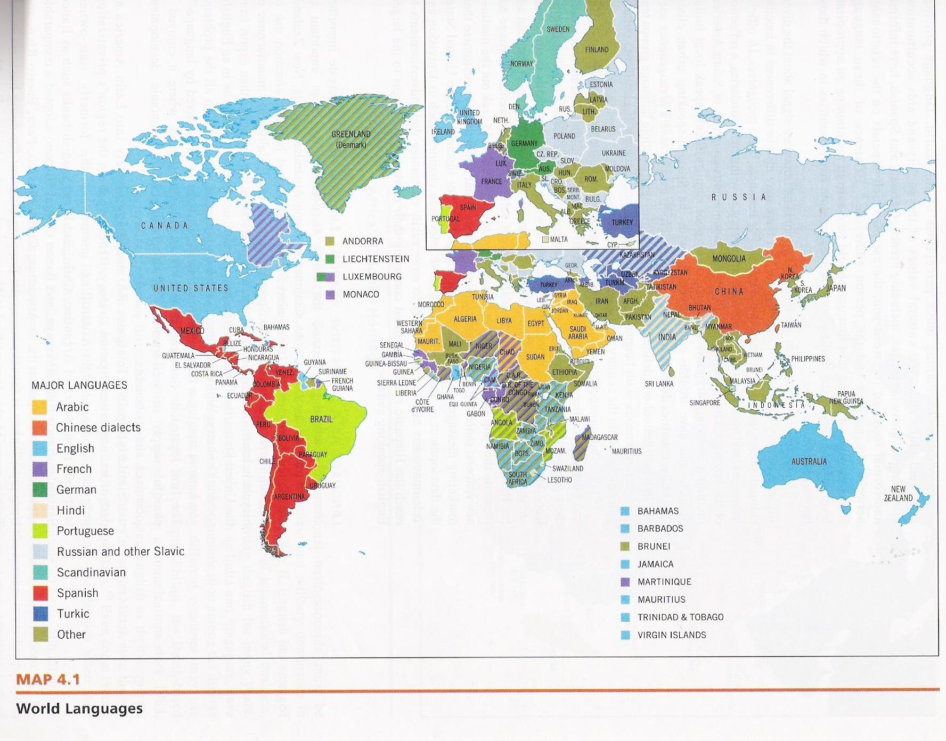

Slide 10
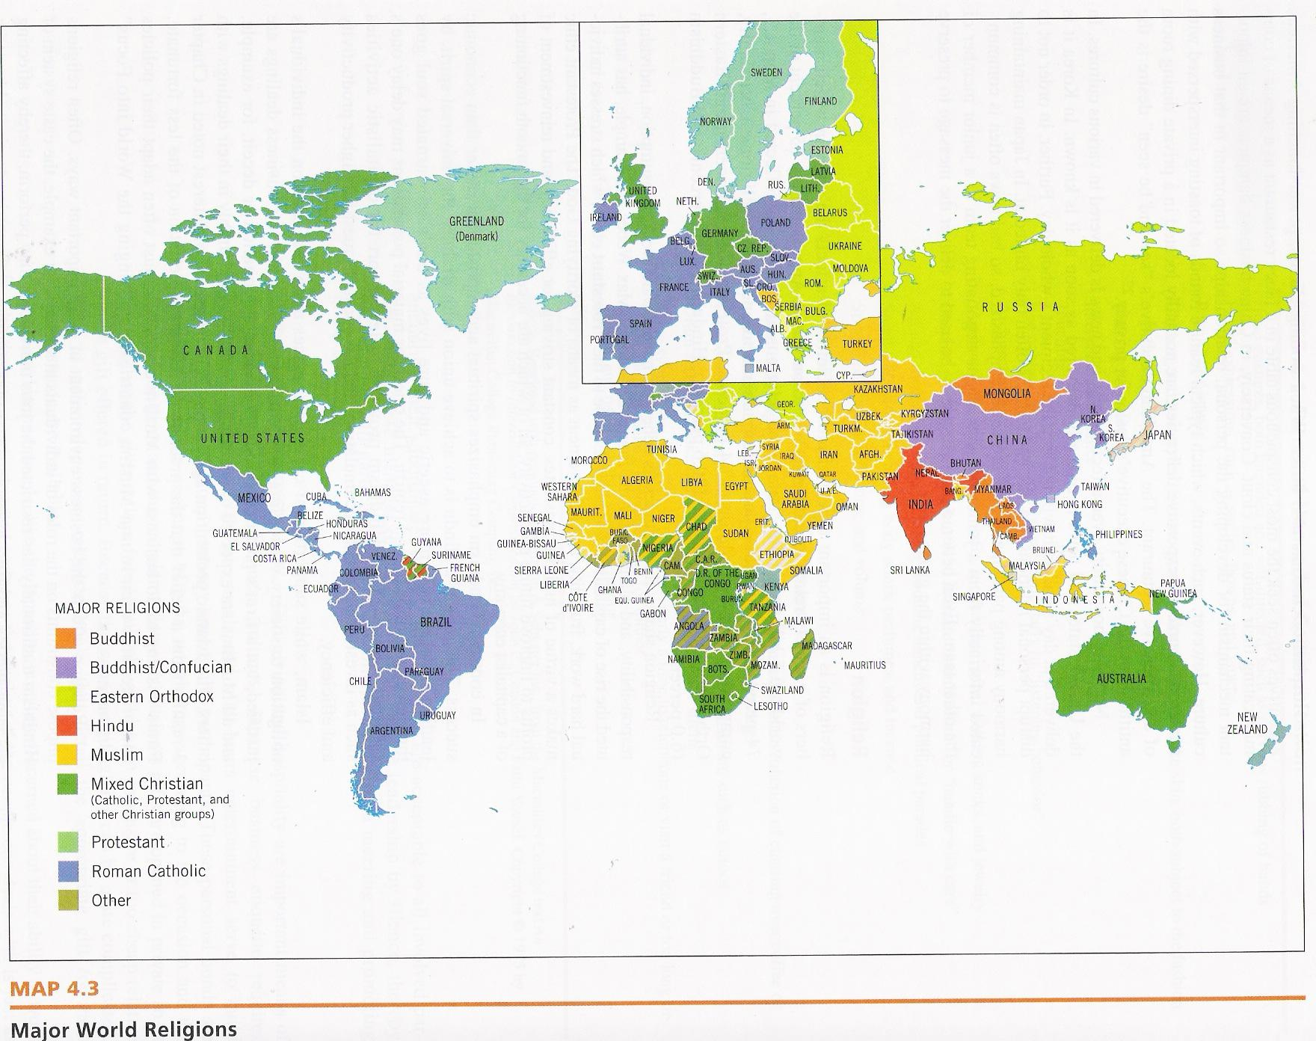

Slide 11
Hofstede’s 5 Dimension of National Culture *
SOCIAL ORIENTATION
INDIVIDUALISM
The interests of the individual take precedence
COLLECTIVISM
The interests of the group take precedence
Relative importance of the interests of the individuals vs. the interests of the group
POWER ORIENTATION
POWER TOLERANCE
Individuals assess authority in view of its perceived rightness or their own personal interests
POWER RESPECT
Authority is inherent in one’s position within a hierarchy
The appropriateness of power/ authority within organization
UNCERTAINTY ORIENTATION
UNCERTAINTY AVOIDANCE
Prefer structure and a consistence routine
UNCERTAINTY ACCEPTANCE
Positive response to change and new opportunities
An emotional response to uncertainty and change
GOAL ORIENTATION
AGGRESSIVE GOAL BEHAVIOUR
Value material possessions, money, and assertiveness
PASSIVE GOAL BEHAVIOUR
Value social relevance, quality of life, and the welfare of others
What motivates people to achieve different goals
TIME ORIENTATION
LONG –TERM OUTLOOK
Value dedication, hard work, and thrift
SHORT–TERM OUTLOOK
Value traditions, social obligations
The extent to which members of a culture adopt a long-term or a short term outlook on work and life

Slide 12
LANGUAGE
CAUSES CULTURE DIFFERENCE?
Different language make different meaning
Translation may incur cost (appointing translator)
May influence the way of communication (verbal or nonverbal)
Ex: Chevrolet Nova for Mexican = not function
RELIGION
Many culture is based on religion
Bcoz within the major religions are many factions whose specific beliefs may affect business
All religions must be respected and avoid any issues that may affect the sensitivity of the religion
Ex: Some Christian groups forgo alcohol, but others do not
Ex: Friday is normally not a workday in predominantly Muslim country bcoz it is a day of worship

Slide 13
ATTITUDE & VALUE
CAUSES CULTURE DIFFERENCE?
The way that culture interpretation same attitude & value
Ex: Sent parent to “Rumah Orang Tua” for western people its good but for east society its impolite to parent
EDUCATION LEVEL
It shows the degree of literacy
Normally it effect the form of communication, it make easy for business negotiation process with country which have high literacy
Needs to be taken seriously for a market that has a very low literacy rate becoz it may affect the level of user acceptance of a product or service

Slide 14
SOCIAL ORGANISATIONS
CAUSES CULTURE DIFFERENCE?
The way society organizes itself.
How the culture considers kinship, social institutions, interest groups and status systems.
Ex: The roles of women
The caste system
TECHNOLOGY & MATERIAL CULTURE
Ability to handle and deal with modern technology
Ex : Business decision making through teleconferencing or dinner in exclusive restaurant

Slide 15
LAW & POLITICS
CAUSES CULTURE DIFFERENCE?
As a codification of the norms of behavior deemed acceptable by the local culture
AESTHETICS
Covers the local culture’s perception of things
About beauty, good taste and design and dictates what is acceptable or appealing to the local eye (Color, music, architecture or brand names)
Users will find the best products or services that have aesthetic values
Ex: Cadbury’s was seen to be luxurious, stylish, expensive for UK but Taiwanese held the image of an old, warm, poor brand and low in quality

Slide 16
FACTORS THAT MAKE CULTURE CHANGE
TECHNOLOGY
- Change the way of life
- Ex: Usage of HP for SMS change the culture of communicate.
ECONOMIES
- The rich (city) vs poor (kampung) person
- Rich can use the latest tech
- It can change the level of purchasing power
- Ex: City person love fast food
POLITICS
- Leader of the country will bring the new idea of life
- Ex:- Tun Mahathir : IT is import
- Pak Lah: Agriculture is important
AGE
- Young people have their own style
- When they getting old then they will change the culture of life.
- Ex: Child – Doraemon
Young – Impian Liyana
Old - Sembilu

Slide 17
HOW THE CULTURE CHANGE
Volunteer
People volunteer to change their culture
Ex: From bad worker to be a good worker
Contact with another culture
People make a contact with foreign
Ex: We change our culture from gardening for food to gardening for hobbies
Enforcement
Government or MNC use rules to change their people @ staff
Ex: Staff must work at celebration day like HARI RAYA, GONG XI FA CHAI or DEEPAVALI

Slide 18
BEHAVIORAL PRACTICS AFFECTING BUSINESS
Group Affiliation / Penggabungan Kumpulan
  Used group for satisfaction
  Ex: Firm will utilize celebrities or experts in advertisement to attract consumer (Dumex milk – celebrities, Pepsi –Athletes, Toothpaste – Dentist, Motorcycle – Engineer)
  Role of Competence / Peranan Kecekapan
  Normally rewards and recognition based on competencies, but due to the culture, elements like seniority and cooperation still has a great influence
  Ex: Family name used in name of business

Slide 19
BEHAVIORAL PRACTICS AFFECTING BUSINESS
Importance of Different Group Membership / Kepentingan Perbezaan Ahli Kumpulan
  In terms of gender, age & family
  Ex: Blue-collar job dominated by male
  Ex: Age-based groups – younger are more preferable o be their corporate members
  Ex: Family-based group – In China family, fun companies are more successful and for them business are heritage
Importance of Work / Kepentingan Kerjaya
  People belief in success and rewards
  Work as a habit
  High need achievement
  Need hierarchy

Slide 20
BEHAVIORAL PRACTICS AFFECTING BUSINESS
Importance of Occupation/ Kepentingan Pekerjaan
  Different national has a different perceptions towards an occupation
  International Business people must understand that some nationals emphasis working for organization not for boss
Self-Reliance / Berdikari
  Motivating workers
  In International Business it might be good or it might be a problem to company becoz people prefer o b close with other family members
  Purchasing decision will be complicated becoz the interrelated roles of family member
Communications / Komunikasi
  Language is important to choose countries that adopt international language such as English, Japanese and etc., otherwise translator is vital.
  Silent language such as color, sign, gesture, cues, body language are also need to be taken into consideration for better understanding and easy o communicate.

Slide 21
RECONCILIATION OF INTERNATIONAL DIFFERENCES
Cultural Awareness / Kesedaran Terhadap Budaya
People can build awareness about other countries culture through:
Competent in their area of expertise
Able to communicate verbally and non verbally in the host country
Flexible, tolerant of ambiguity and sensitive to cultural differences
Motivated to succeed and able to enjoy the challenge of working in other countries
Willing to learn about the host country’s culture
Supported by the families
Grouping Countries / Kumpulan Mengikut Negara
Some countries are relatively similar to one another, usually because of similar in language, religion, level of economic development, sharing border and ethnicity. However, international managers must deal with it cautiously to avoid misinterpretation

